Slide 1
WHITE LION
CREATED BY ERGASHEV DONIYIRBEK

Slide 2
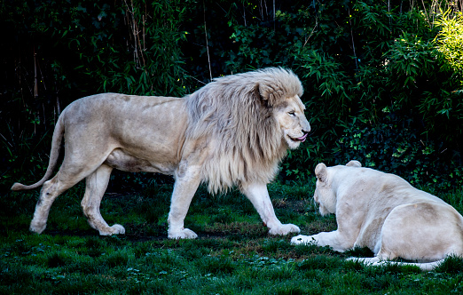
WHITE LION

Slide 3
DESCRIPTION
White lions are not albinos. Their white color is caused by a recessive trait, called leucism, derived from a less-severe mutation in the same gene that causes albinism, similar to the gene responsible for white tigers. They vary from blonde to near-white. This coloration does not appear to pose a disadvantage to their survival. White lions were considered to have been technically extinct in the wild between 1992 and 2004, when the Global White Lion Protection Trust achieved the first successful reintroduction of white lions to their natural habitat. These prides have continued to hunt and breed successfully in the wild, whilst other occurrences of white lion births have been reported in the greater Kruger region since then.

Slide 4
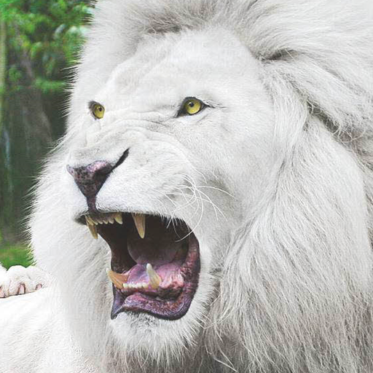

Slide 5
Breeding and genetics
A recessive gene gives white lions their unusual colors. A similar gene also produces white tigers. White lions can therefore be selectively bred for zoos, animal shows and wildlife parks. Such breeding involves inbreeding and can result in inbreeding depression (genetic defects, reduced fertility, and physical defects), although this has not yet been found to cause hind-limb paralysis or serious heart defects, which would indicate a severe level of inbreeding. Some are concerned about white lions mating with lions of other alleles, due to possible extinction of the white lion allele. However, this is not valid as the offspring will inherit the recessive white gene and therefore make it possible to produce white offspring in a later generation, thus making the allele more widespread. Some critics maintain that white lions should not be introduced into the wild because of the inbreeding that has taken place in zoos and breeding camps. However, ethical reintroduction programs such as The Global White Lion Protection Trust have ensured through the use of scientific methodologies that the lions in their program are not inbred

Slide 6
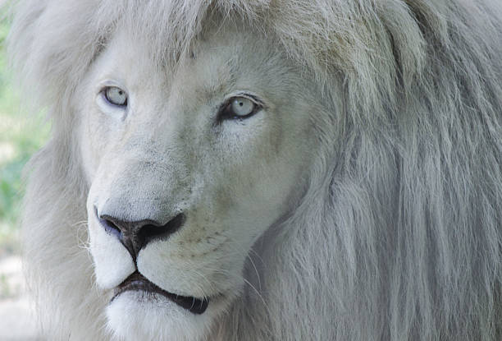

Slide 7
Genetics
Genetically, the white lion is the same subspecies as the tawny South African lion (Panthera leo melanochaita), which is found in some wildlife reserves in South Africa, and in zoological parks around the world. White lions are not albinos, but leucistic. They have pigment visible in the eyes (which may be the normal hazel or golden color, blue-gray, or green-gray), paw pads and lips. Blue-eyed white lions exist and may be selectively bred. The leucistic trait is due to a recessive mutation in the gene for Tyrosinase (TYR), an enzyme responsible for the production of melanins.^{[28]} More severe mutations in the same gene have been found to cause albinism in many species, while another less severe mutation in the same gene is responsible for the Chinchilla coloring trait seen in several mammals. Reduced pigment production decreases the deposition of pigment along the hair shaft, restricting it to the tips. The less pigment there is along the hair shaft, the paler the lion. As a result, "white" lions range from blonde to near-white. The males have pale manes and tail tips instead of the usual dark tawny or black. In 2013, the specific genetic marker that determines the unique coloration of white lions was identified, after a 7-year study led by the Global White Lion Protection Trust and partnering several different countries.^{[4]}

Slide 8
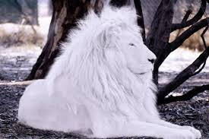

Slide 9
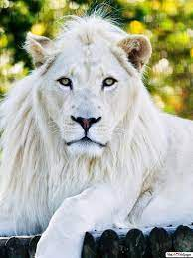
TOP 5 INTERESTING FACTS ABOUT WHITE LION

Slide 10
TOP 5
The earliest recorded sighting of a white lion was in 1938.

Slide 11
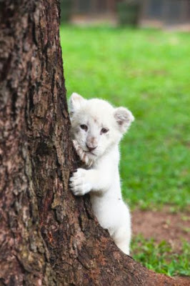

Slide 12
TOP 4
The colour of white lions is not always near white. Some have the blonde colour; however, they are still called white lions.

Slide 13
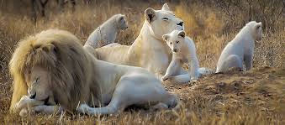

Slide 14
TOP 3
African people used to believe that white lions are messengers of God and they represent purity. (It’s not informal)

Slide 15
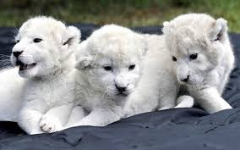

Slide 16
Top 2
White lions are only born if the mother and father have the same gene.

Slide 17
Top 1
The idea that white lions cannot survive in the wild is due to lack of camouflage.

Slide 18
end
White lions vey unque and beautiful animals. They are great miracle of nature, but re must proctes them. Some people don’t appreciate this blessing. That’s why they are now a rare animal species. A person can cause such a strange animal to disappear from the face of the earth. They don’t know nature will surely punish us fot this act. PUNISHMEND CAN BE VERY SERVED.

Slide 19
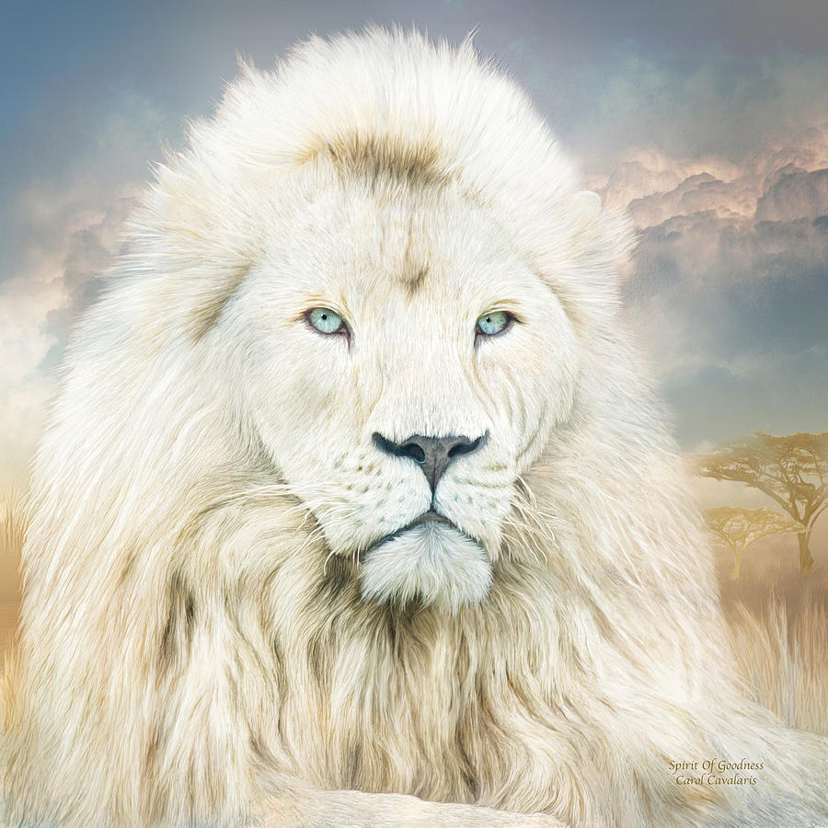

Slide 20


